Slide 1

AstroSAGE
Analysis by Juned ShAIKH
14-01-2025

Slide 2

ASTROLOGY
Welcome to AstroSage! Your abode to every form of online astrology consultation. From Vedic astrology to KP system, and everything in between, including Birth chart, Numerology, Palmistry, Tarot Reading, Aura Reading, Vastu, Spiritual Healing, Online Horoscopes, Chinese Astrology, Western Astrology, Vedic Astrology, Zodiac readings (both Sun and Moon signs) and more. Consult the best astrologers of India for instant free astrology online consultation and seek solutions to your problems.
Astrology is a method of predicting mundane events based upon the assumption that the celestial bodies—particularly the planets and the stars considered in their arbitrary combinations or configurations (called constellations)—in some way either determine or indicate changes in the sublunar world

Slide 3
How ASTROSAGE WORK’s ?
Information Gathering
Analysis
Horoscope (Action)
Once you called us we gather the information like date, time, and place of birth.
We do analysis on the data provided by the user with the large data set to provide accurate Horoscope Predictions.
Once the Horoscope is Determine we guide user with the Do’s and Don’t as per the Kundli of the user

Slide 4





ASTROSAGE DATA Overview
Number of Active User : 10344, Reflecting the broad network of user we have and impact we are creating in there lives
Number of Guru’s : 131, Make sure to provide accurate information and handle client swiftly.
Geographical Coverage : Service Reaches 28 States and 365 Cities in India, Shows Nation Wide Penetration.

Slide 5

ASTROSAGE DATA Cleaning
Removing Duplicate in order for accurate analysis of Raw Data to get Accurate Results.
Missing Value are replaced with the Average or with the valid format in the required column to maintain the data consistency and accuracy.
This Data-Set allows in-dept understanding of ASTROSAGE market presence and operational scope.
High Quality Data is crucial for analyzing sales trends, customer behavior , and agents performance.
Insights from user demographics and order volumes are key to optimizing marketing strategies and expanding product offerings.

Slide 6
ANALYTICAL APPROCH and TOOLS USED:
Data Cleaning: Utilized Functions Like TRIM, CLEAN and Remove Duplicates to ensure data accuracy.
Data Enrichment: Enhanced the dataset with additional variables using VLOOKUP to across reference external data source.
Descriptive Analysis: Employed PivotTables for summarizing key metrics and identifying sales patterns across different regions and product categories.
Customer Segmentation: Applied SORT and FILTER functions to classify customers based on purchasing behavior and demographics.
Visualizations: Created dynamic charts and dashboards for data representation, enabling interactive data exploration.

Slide 7
Sales Generated
Row Labels | Sum of amount
Call | 168520.6183
Chat | 45494.68333
Complementary | 0.00
public_live_Call | 50.597
Grand Total | 214065.8987

Slide 8
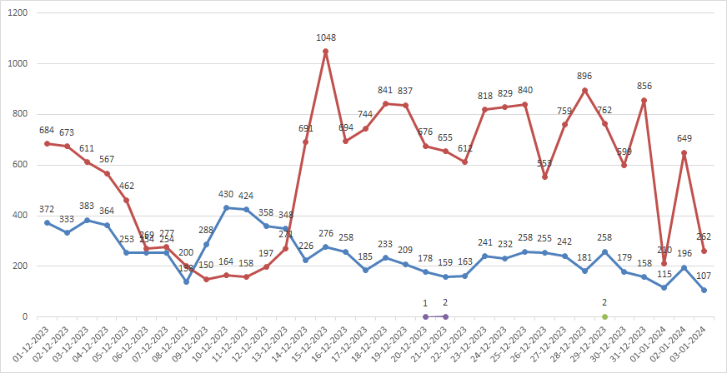
Call / Chat Volume:
Red is Chat and Blue is Call

Slide 9
AVERAGE CUSTOMER SATISFACTION SCORE BY MONTH
Months | Average of rating
Jan | 2.676413255
Dec | 2.949637572
Grand Total | 2.93463446

Slide 10
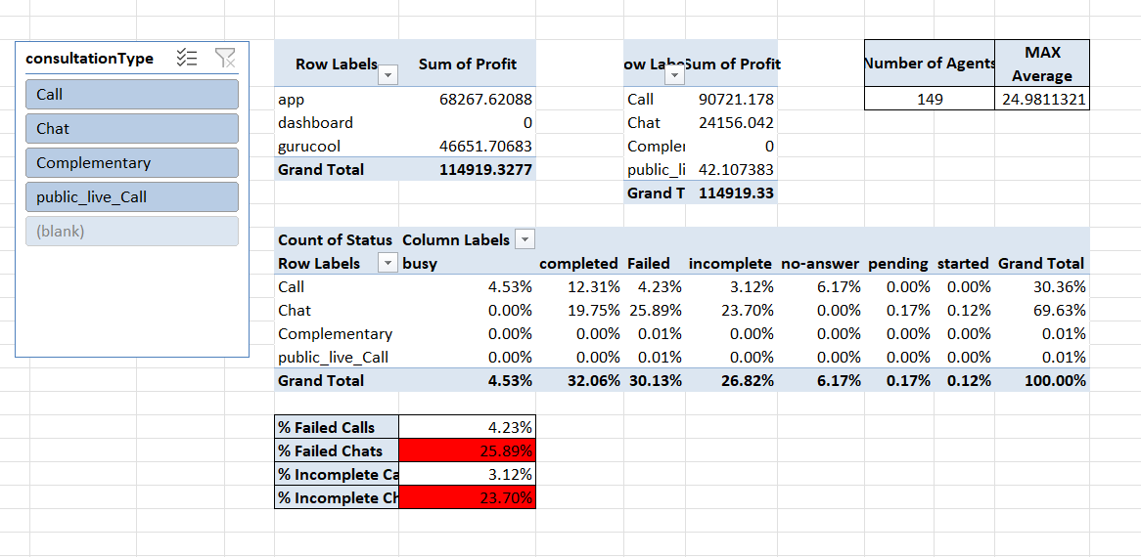
Call HandeLING By GuRUS
Insights:-
The Agent per call/chats is with the limit that is 24.98
The Number of Failed chat is higher 25.89%
The Number of Incomplete chat is also higher at 23.70%

Slide 11
TECHNOLOGY/ TOOL TO IMPROVE Operation Performance
Recommendation:-
Interactive Voice Response (IVR) Systems:- We can introduce IVR system in order to guide user properly to the GURU as per the option selection eg:- Language Selection, Problem Selection.
Workforce Management Tools:- We can optimize our work force login adherence with the WMT tool so if we manage people as per the peek and or upward trends
Customer Relationship Management (CRM) Systems:- We can invest in good CRM systems so it will easier for the Agents to work on the assigned cases and improve overall efficiency and attend more call/chats and reduce failed/unattended calls/chats.
Quality Monitoring and Training Tools:- A good Quality Monitoring and Training Tools will help to segregate task accordingly and will also train agent as per the system requirements.

Slide 12
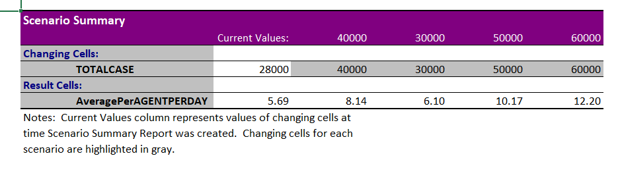
HANDLING cases FLOW FROCATING VALUES
Insights:-
If we provide right training to the agent then we can achieve the forecasted result if the average cases per agent per increases we can handle the peek season pretty smoothly

Slide 13
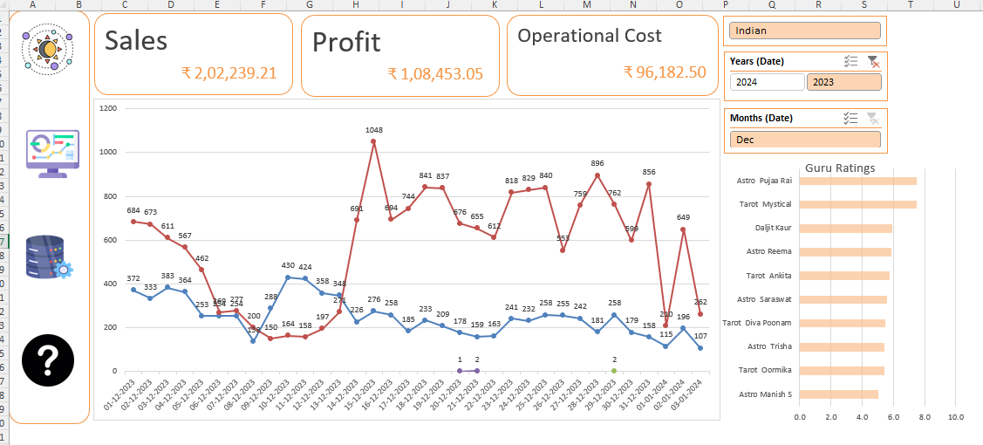
DASHBOARD

Slide 14
CONCLUSION
Recommendation:- (Solutions)
To Solve the Call/Chat Failure and Incompletion we should invest in a good CRM and Calling System with IVR. So Agent can make a track of failed calls/chats and can manage it more efficiently and this will also make a slight improvement in the customer satisfaction rate.
Invest in a good Calling system / Work Force Management system will improve the Agent Cases per day count so this will also track the Performance of the Agent thus management can track the agent performance and KPI’s
A CRM System can also be used to provide knowledge base articles to the user to handle the client more effectively and improve repetitive call ration so the sales will also improve drastically.
Investment in a Training System so agents will be on track with the market and organizational trends. To handle client in more professional manner to increase sales and improve overall rating for the organization.

